Slide 1
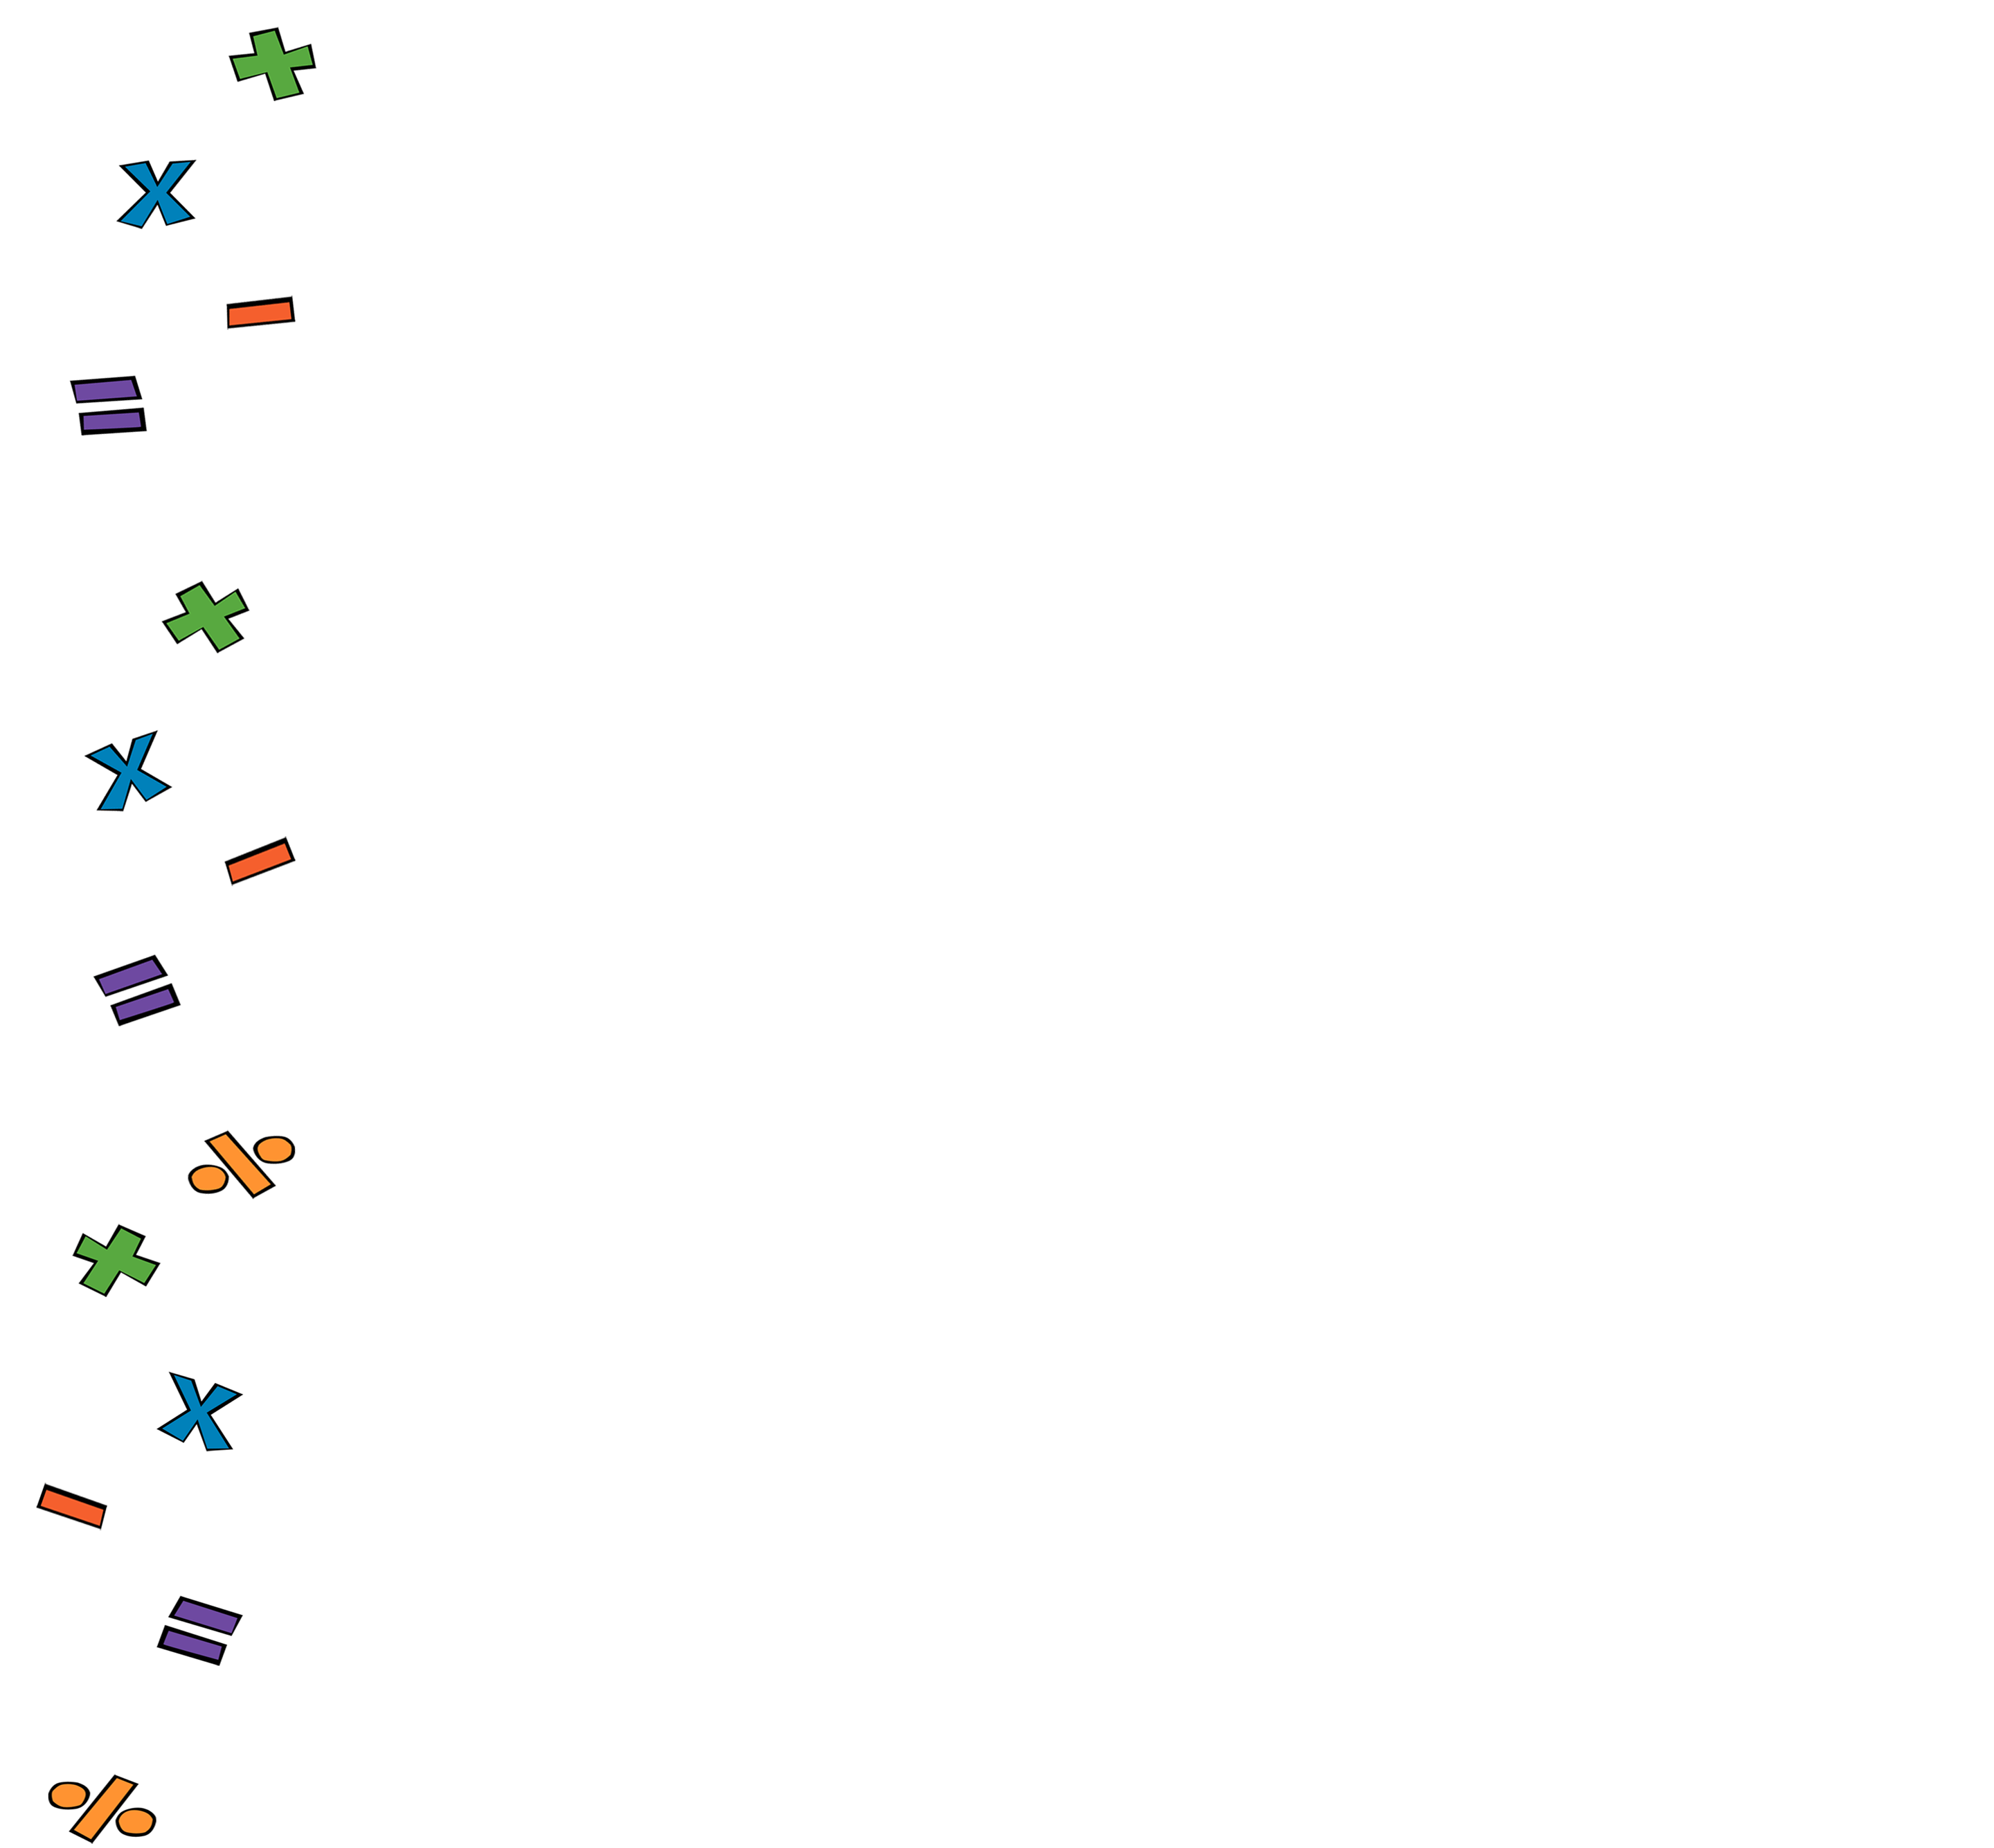
QUADRATICS

Slide 2
Prerequisites
Before watching this series, we recommend you’re familiar with:
Basic Algebraic Notation
Indices
Expanding Brackets
Factorsing by Taking out Common Factors
Solving Linear Equations
Plotting Coordinates
Sketching Linear Graphs
Algebraic Fractions

Slide 3
QUADRATICS
Video 1: Factorising Quadratic Expressions

Slide 4
Video 1: Factorising Quadratic Expressions
$$3x^{2}−5x −2$$
$$x^{0}$$
$$1$$
$$3 × \left(−2\right)=−6$$
$$×:−6$$
$$+:−5$$
$$3x^{2}−6x+1x −2$$
$$−6×1=−6$$
$$−6+1=−5$$
$$3x(x−2)+1(x −2)$$
Factorise the whole bracket (x – 2) out
Use -6 and 1 !
Factorise 3x out of the first 2 terms and 1 out of the second 2
$$(x−2)(3x+1)$$
Factorised!!!

Slide 5
Video 1: Factorising Quadratic Expressions
Factorise the following quadratic expressions:
$2x^{2}+7x+3$
$x^{2}−5x−24$
$2x^{2}−x−15$
$3x^{2}+8x+4$
$3x^{2}−11x+6$
You try!

Slide 6
QUADRATICS

Slide 7
Prerequisites
Before watching this series, we recommend you’re familiar with:
Basic Algebraic Notation
Indices
Expanding Brackets
Factorsing by Taking out Common Factors
Solving Linear Equations
Plotting Coordinates
Sketching Linear Graphs
Algebraic Fractions

Slide 8
QUADRATICS
Video 2: Incomplete Quadratics

Slide 9
Video 2: Incomplete Quadratics
Case 1: Missing the Constant
Just take out the common factors
$$3x^{2}+6x$$
$$3x(x+2)$$
Factorised!!!

Slide 10
Video 2: Incomplete Quadratics
Case 2: Missing the Linear Term
May be impossible to factorise!
$$3x^{2}+2$$
Nothing to Factorise here!!!

Slide 11
Video 2: Incomplete Quadratics
Case 2: Missing the Linear Term
May be the Difference of Two Squares
$$9x^{2}−36$$
Recall: $\left(A+B\right)\left(A−B\right)=A^{2}−B^{2}$
So, $9x^{2}−36=(3x −6)(3x+6)$
Factorised!!!

Slide 12
Video 2: Factorising Incomplete Quadratics
Factorise the following quadratic expressions:
$x^{2}−3x$
$x^{2}+7x$
$x^{2}−49$
$9x^{2}−4$
$4x^{2}−1$
You try!

Slide 13
QUADRATICS

Slide 14
Prerequisites
Before watching this series, we recommend you’re familiar with:
Basic Algebraic Notation
Indices
Expanding Brackets
Factorsing by Taking out Common Factors
Solving Linear Equations
Plotting Coordinates
Sketching Linear Graphs
Algebraic Fractions

Slide 15
QUADRATICS
Video 3: Solve by Factorising

Slide 16
Video 3: Solve by Factorising
$$x^{2}+12=−7x$$
$$x^{2}+12+7x=0$$
Use +3 and +4
Factorise!
Move everything to the LHS and order the trinomial
A product is zero when one of the factors is zero
$$x^{2}+7x+12=0$$
$$x^{2}+3x+4x+12=0$$
$$+:7$$
$$×:12$$
$$x(x+3)+4(x+3)=0$$
$$(x+3)(x+4)=0$$
$$x+3=0$$
$$∴ x=−3$$
$$x+4=0$$
$$∴ x=−4$$

Slide 17
Video 3: Solve Quadratic by Factorising
Solve the following quadratic equations by factorizing them:
$x^{2}−4x−5=0$
${2x}^{2}−3x−2=0$
$x^{2}−5x=−6$
$2x^{2}=15−7x$
You try!

Slide 18
QUADRATICS

Slide 19
Prerequisites
Before watching this series, we recommend you’re familiar with:
Basic Algebraic Notation
Indices
Expanding Brackets
Factorsing by Taking out Common Factors
Solving Linear Equations
Plotting Coordinates
Sketching Linear Graphs
Algebraic Fractions

Slide 20
QUADRATICS
Video 4: Solve incomplete quadratics by Factorising

Slide 21
Video 4: Solve Incomplete Quadratics by factoring
Case 1: Missing the Constant
One solution is always zero
$$2x^{2}−2x=0$$
$$2x\left(x−1\right)=0$$
$$2x=0$$
$$∴ x=0$$
$$x−1=0$$
$$∴ x=1$$

Slide 22
Video 4: Solve Incomplete Quadratics by factoring
Case 2: Missing the Linear Term
Solutions are equal and opposite
(Must be Difference of 2 Squares)
$$16x^{2}−1=0$$
$$(4x+1)\left(4x−1\right)=0$$
$$∴ x=−\frac{1}{4}$$
$$4x+1=0$$
$$∴ 4x=−1$$
$$∴ x=\frac{1}{4}$$
$$4x−1=0$$
$$∴ 4x=1$$

Slide 23
Video 4: Solve Incomplete Quadratics by Factorising
Solve the following quadratic equations by factorising them:
${3x}^{2}−x=0$
${10x}^{2}−55x=0$
$x^{2}=6x$
$4x^{2}−1=0$
$36x^{2}=16$
You try!

Slide 24
QUADRATICS

Slide 25
Prerequisites
Before watching this series, we recommend you’re familiar with:
Basic Algebraic Notation
Indices
Expanding Brackets
Factorsing by Taking out Common Factors
Solving Linear Equations
Plotting Coordinates
Sketching Linear Graphs
Algebraic Fractions

Slide 26
QUADRATICS
Video 5: Other Way of Solving Quadratics

Slide 27
Video 5: Other Way of Solving
$$x^{2}−4=0$$
Method also works if you don’t have a perfect square
But not if the number is positive!
Still get equal and opposite solutions
Single “x” term so treat like linear
Take square root of both sides
$$x^{2}=4$$
$$\sqrt{x^{2}}=\sqrt{4}$$
$$x=±2$$
$$x^{2}−7=0$$
$$x^{2}+5=0$$
$$x^{2}=7$$
$$x^{2}=−5$$
Impossible!!!
$$x=±\sqrt{7}$$

Slide 28
Video 5: Other way of Solving
Solve the following incomplete quadratics by separating the ”x” term from the number and taking the square root:
$x^{2}−9=0$
${9x}^{2}−4=0$
${1−9x}^{2}=0$
You try!

Slide 29
QUADRATICS

Slide 30
Prerequisites
Before watching this series, we recommend you’re familiar with:
Basic Algebraic Notation
Indices
Expanding Brackets
Factorsing by Taking out Common Factors
Solving Linear Equations
Plotting Coordinates
Sketching Linear Graphs
Algebraic Fractions

Slide 31
QUADRATICS
Video 6: Completing the square

Slide 32
Video 6: Completing the Square
$$x^{2}+2x−15=0$$
$$÷2$$
Subtract 1
We must go on a bit of a detour!
Now you can proceed as for the previous video
Extend method of previous video to complete quadratics
Take the square root of both sides
$$1$$
${\left(x+1\right)}^{2}−1$
$−15=0$
${\left(x+1\right)}^{2}−16=0$
$${\left(x+1\right)}^{2}$$
${\left(x+1\right)}^{2}=16$
$$=(x+1)(x+1)$$
$$\sqrt{{\left(x+1\right)}^{2}}=\sqrt{16}$$
$$=x^{2}+1x+1x+1$$
$$=x^{2}+2x+1$$
$$x+1=±4$$
$$∴$$
$$+4−1=3$$
$$x^{2}+2x+1={\left(x+1\right)}^{2}$$
$$x=±4 −1=$$
$$−4−1=−5$$
$$∴$$
$x^{2}+2x={\left(x+1\right)}^{2}−1$

Slide 33
Video 6: Completing the Square
$${3x}^{2}+10x−8=0$$
Start by dividing by the coefficient of x²
Finish as for the previous example
Now complete the square
As you can tell this is quite laborious!
Let’s look at another example
$$3$$
$$3$$
Luckily, you don’t have to this every time!
$$x^{2}+\frac{10}{3}x−\frac{8}{3}=0$$
$$x+\frac{5}{3}=±\frac{7}{3}$$
$${\left(x+\frac{5}{3}\right)}^{2}−\frac{25}{9}$$
$$−\frac{8}{3}=0$$
$$x=±\frac{7}{3}−\frac{5}{3}$$
$${\left(x+\frac{5}{3}\right)}^{2}−\frac{49}{9}=0$$
$$+\frac{7}{3}−\frac{5}{3}=\frac{2}{3}$$
$${\left(x+\frac{5}{3}\right)}^{2}=\frac{49}{9}$$
$$x=$$
$$−\frac{7}{3}−\frac{5}{3}=−\frac{12}{3}=−4$$

Slide 34
Video 6: Completing The Square
Solve the following quadratic equations by completing the square:
$x^{2}+10x+21=0$
${8x}^{2}−10x−3=0$
You try!

Slide 35
QUADRATICS

Slide 36
Prerequisites
Before watching this series, we recommend you’re familiar with:
Basic Algebraic Notation
Indices
Expanding Brackets
Factorsing by Taking out Common Factors
Solving Linear Equations
Plotting Coordinates
Sketching Linear Graphs
Algebraic Fractions

Slide 37
QUADRATICS
Video 7: The Quadratic Formula

Slide 38
Video 7: The Quadratic Formula
By completing the square of the general expression
$ax^{2}+bx+c=0$,
You can derive the Quadratic Formula which says that the solutions to a quadratic equations are given by:
$$x_{1,2}=\frac{−b±\sqrt{b^{2}−4ac}}{2a}$$
If you’re up for a challenge, try to derive the quadratic formula by yourself!

Slide 39
Deriving the Quadratic Formula
$$ax^{2}+bx+c=0$$
$$x^{2}+\frac{b}{a}x+\frac{c}{a}=0$$
Dividing both sides by $a$
$${\left(x+\frac{b}{2a}\right)}^{2}−\frac{b^{2}}{4a^{2}}+\frac{c}{a}=0$$
Completing the square
$${\left(x+\frac{b}{2a}\right)}^{2}=\frac{b}{4a^{2}}−\frac{c}{a}=\frac{b^{2}−4ac}{4a^{2}}$$
Subtracting $−\frac{b^{2}}{4a^{2}}+\frac{c}{a}$ from both sides and adding the fractions
$$x+\frac{b}{2a}=±\frac{\sqrt{b^{2}−4ac}}{2a}$$
Taking the square root of both sides
$$x=−\frac{b}{2a}±\frac{\sqrt{b^{2}−4ac}}{2a}$$
Subtracting $\frac{b}{2a}$from both sides
$$x=\frac{−b±\sqrt{b^{2}−4ac}}{2a}$$
Adding the fractions

Slide 40
QUADRATICS

Slide 41
Prerequisites
Before watching this series, we recommend you’re familiar with:
Basic Algebraic Notation
Indices
Expanding Brackets
Factorsing by Taking out Common Factors
Solving Linear Equations
Plotting Coordinates
Sketching Linear Graphs
Algebraic Fractions

Slide 42
QUADRATICS
Video 8: Using The Quadratic Formula

Slide 43
Video 8: Using The Quadratic Formula
If
$ax^{2}+bx+c=0$,
Then:
$$x_{1,2}=\frac{−b±\sqrt{b^{2}−4ac}}{2a}$$
Read off a, b and c
Substitute them into the formula
Let’s try this out
$$6x^{2}−11x+3=0$$
$$a=6$$
$$b=−11$$
$$x_{1,2}=\frac{−(−11)±\sqrt{{(−11)}^{2}−4×6×3}}{2×6}$$
$$c=3$$
$$\frac{3}{2}$$
$$x_{1,2}=$$
$$\frac{1}{3}$$

Slide 44
Video 8: Using the Quadratic Formula
Solve the following quadratic equations by completing the square:
${2x}^{2}+11x+5=0$
${3x}^{2}−10x+3=0$
$x^{2}=6−x$
$x\left(x+10\right)=−21$
You try!

Slide 45
QUADRATICS

Slide 46
Prerequisites
Before watching this series, we recommend you’re familiar with:
Basic Algebraic Notation
Indices
Expanding Brackets
Factorsing by Taking out Common Factors
Solving Linear Equations
Plotting Coordinates
Sketching Linear Graphs
Algebraic Fractions

Slide 47
QUADRATICS
Video 9: Quadratic Functions

Slide 48
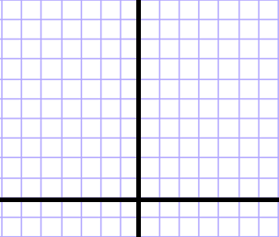
Video 9: Quadratic Functions
$$y=ax^{2}+bx+c$$
$$x$$
$$−3$$
$$−2$$
$$−1$$
$$0$$
$$1$$
$$2$$
$$3$$
The shape is called PARABOLA
$$y=x^{2}$$
Let’s use the simplest quadratic to figure it out
How does y vary as x varies?
And create a table of points
Take a=1, b=0, c=0
$$y$$
$$9$$
$$4$$
$$1$$
$$0$$
$$1$$
$$4$$
$$9$$
$$y$$
$$9$$
$$4$$
$$1$$
$$−3$$
$$−2$$
$$−1$$
$$0$$
$$1$$
$$2$$
$$3$$
$$x$$

Slide 49
QUADRATICS

Slide 50
Prerequisites
Before watching this series, we recommend you’re familiar with:
Basic Algebraic Notation
Indices
Expanding Brackets
Factorsing by Taking out Common Factors
Solving Linear Equations
Plotting Coordinates
Sketching Linear Graphs
Algebraic Fractions

Slide 51
QUADRATICS
Video 10: Sketching Quadratics

Slide 52
Video 10: Sketching Quadratics
$$y=3x^{2}+10x−8$$
y-intercept
$$y=3{×0}^{2}+10×0−8=−8$$
Facing up since positive a
Solve the quadratic equation
What’s y when x=0
What’s x when y=0
0 $=3x^{2}+10x−8$
$$\frac{2}{3}$$
$$x_{1,2}=\frac{−10±\sqrt{{10}^{2}−4×3×(−8)}}{2×3}=$$
x-intercepts
$$−4$$
$$−4$$
$$\frac{2}{3}$$
$$−8$$

Slide 53
Video 10: Sketching Quadratics
$$y=x^{2}+5x$$
$$y=0^{2}+5×0=0$$
Facing up since positive a
What’s y when x=0
What’s x when y=0
Solve the quadratic equation
0 $=x^{2}+5x$
$$x\left(x+5\right)=0$$
$$x=0$$
$$x+5=0 ∴x=−5$$
x-intercepts
$$−5$$

Slide 54
Video 10: Sketching Quadratics
$$y={−x}^{2}+7$$
$$y={−0}^{2}+7=7$$
Facing down since negative a
What’s y when x=0
What’s x when y=0
0 $={−x}^{2}+7$
Solve the quadratic equation
$$x^{2}=7$$
$$x=±\sqrt{7}$$
x-intercepts
$$7$$
$$−\sqrt{7}$$
$$+\sqrt{7}$$

Slide 55
Video 10: Sketching Quadratics
Sketch the following quadratic functions:
${y=x}^{2}−5x+6$
${y=−12x}^{2}+16x−5$
$y={−x}^{2}+16$
$y=2x^{2}−3x$
You try!

Slide 56
QUADRATICS

Slide 57
Prerequisites
Before watching this series, we recommend you’re familiar with:
Basic Algebraic Notation
Indices
Expanding Brackets
Factorsing by Taking out Common Factors
Solving Linear Equations
Plotting Coordinates
Sketching Linear Graphs
Algebraic Fractions

Slide 58
QUADRATICS
Video 11: Quadratics Inequalities

Slide 59
Video 11: Quadratic Inequalities
$$3x^{2}+10x−8>0$$
$$y=3x^{2}+10x−8$$
Start by sketching the function
$$y−intercept=−8$$
$$\frac{2}{3}$$
$$x−intercepts=x_{1,2}=\frac{−10±\sqrt{{10}^{2}−4×3×(−8)}}{2×3}=$$
$$−4$$
$$x>\frac{2}{3} or x<−4$$
$$−4$$
$$\frac{2}{3}$$
$$−8$$

Slide 60
Video 11: Quadratic Inequalities
$$3x^{2}+10x−8<0$$
Start by sketching the function
$$−4$$
$$\frac{2}{3}$$
$$−8$$
$$−4<x<\frac{2}{3}$$

Slide 61
Video 11: Sketching Quadratics
Solve the following quadratic inequalities:
$x^{2}−5x+6>0$
${−12x}^{2}+16x−5≥0$
${−x}^{2}−16>0$
$2x^{2}−3x≤0$
You try!

